Slide 1
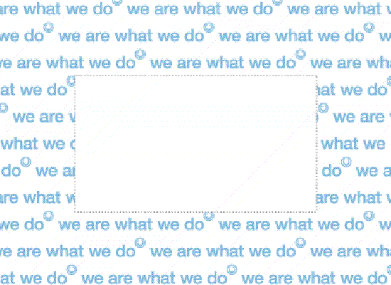
Hug Someone
Whenever you get the chance
...So show someone who you care about
Give someone a hug
That you really do care about them!
It doesn't take much effort

Slide 2
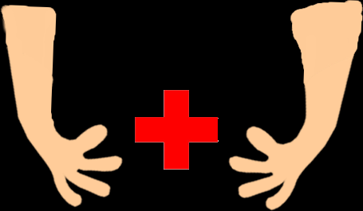
Hug Someone
Even the simple act of giving a hug ,can influence the People to do good things themselves throughout their day!
Its scientifically proven that hugs can lower the risk of heart disease!

Slide 3
Hug Someone
Hugs show compassion in more than a 1000 words
So don't’ be shy, and give someone a hug!

